Slide 1






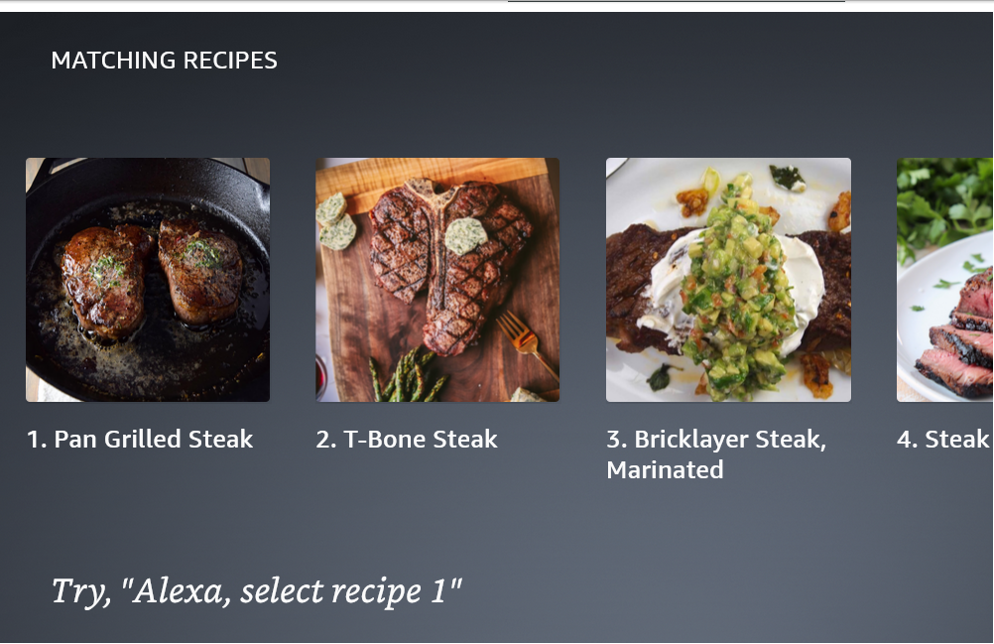
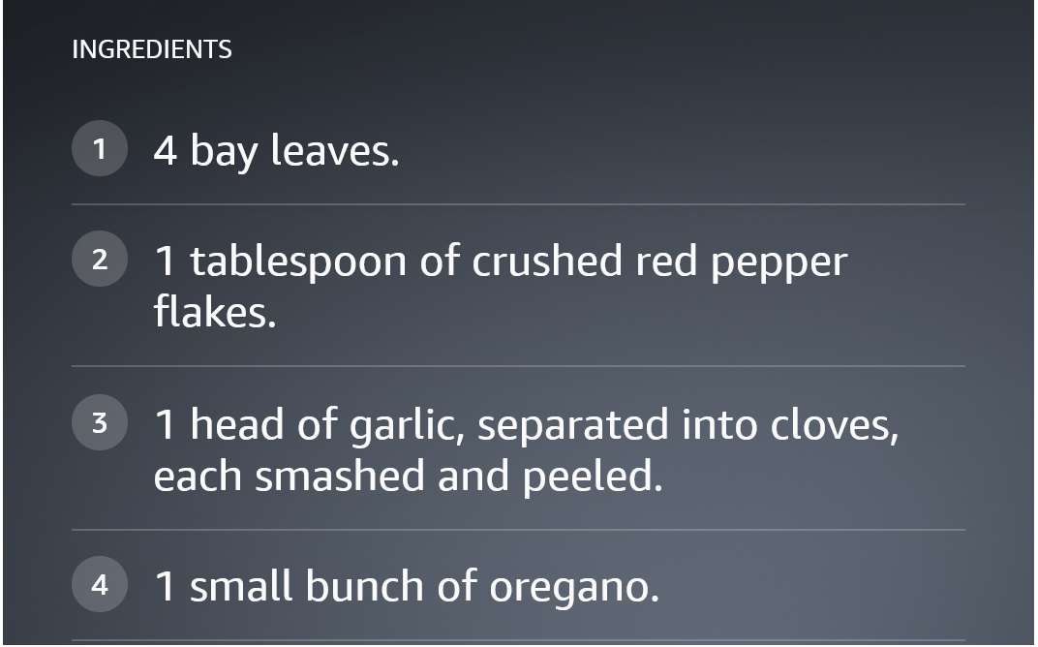
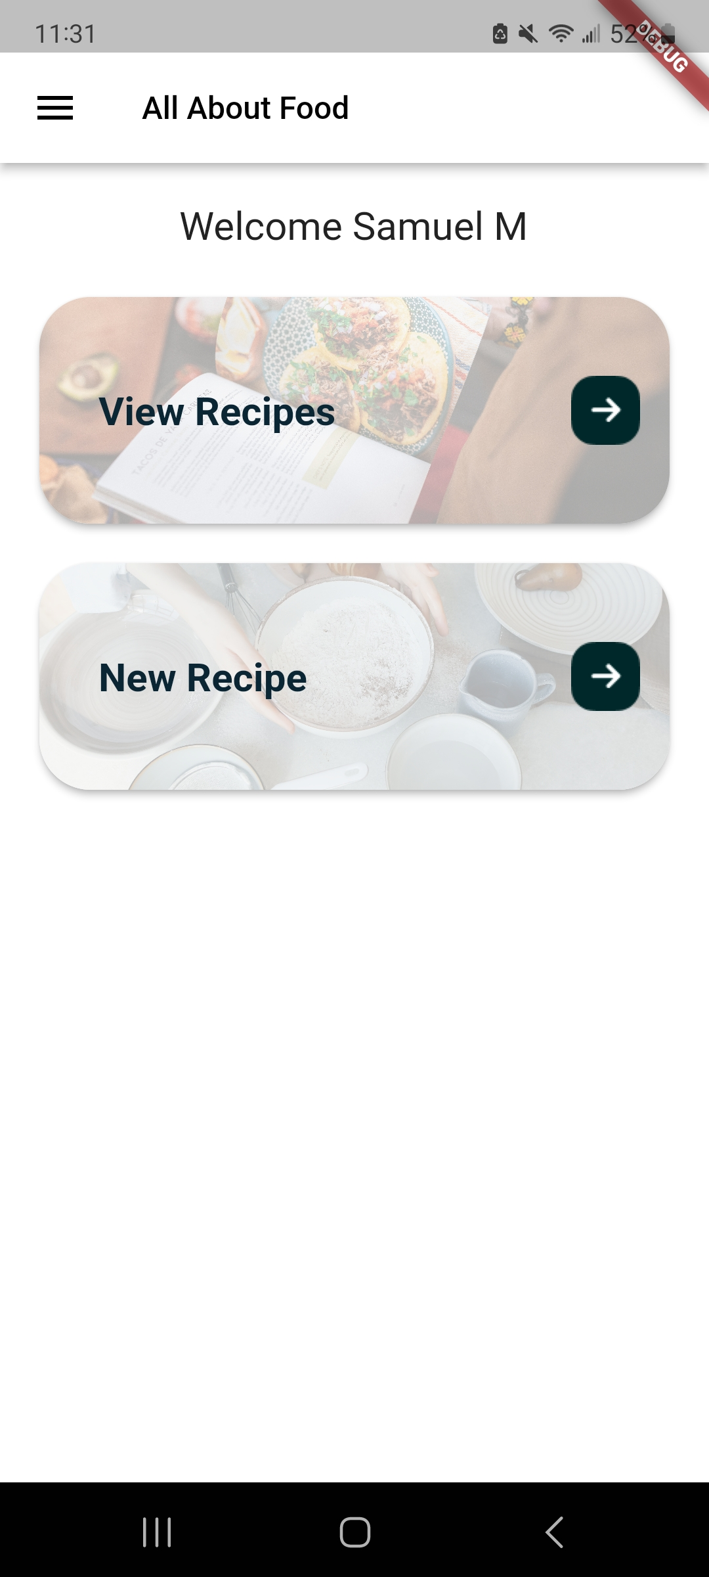
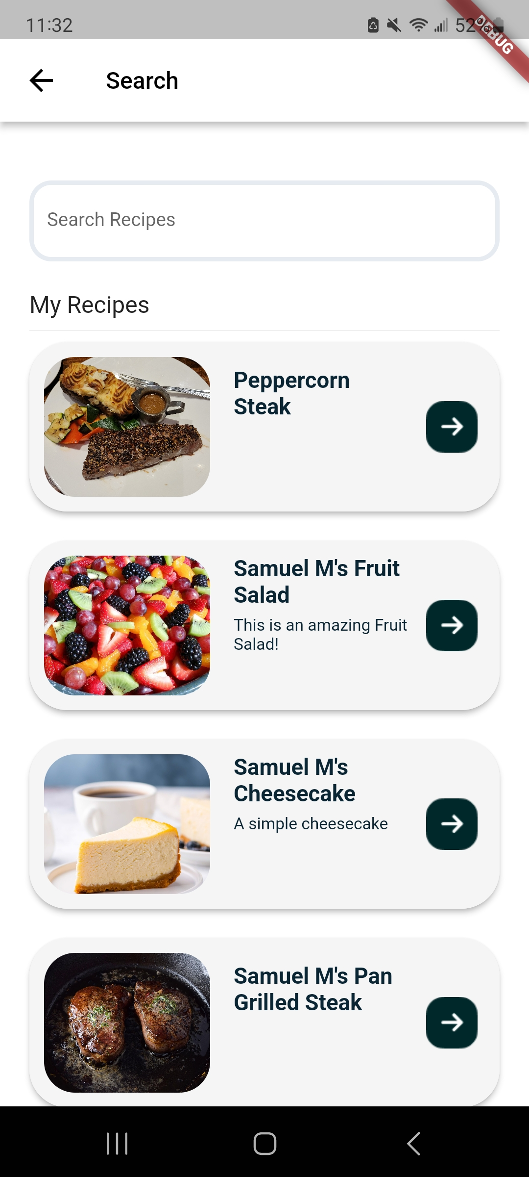
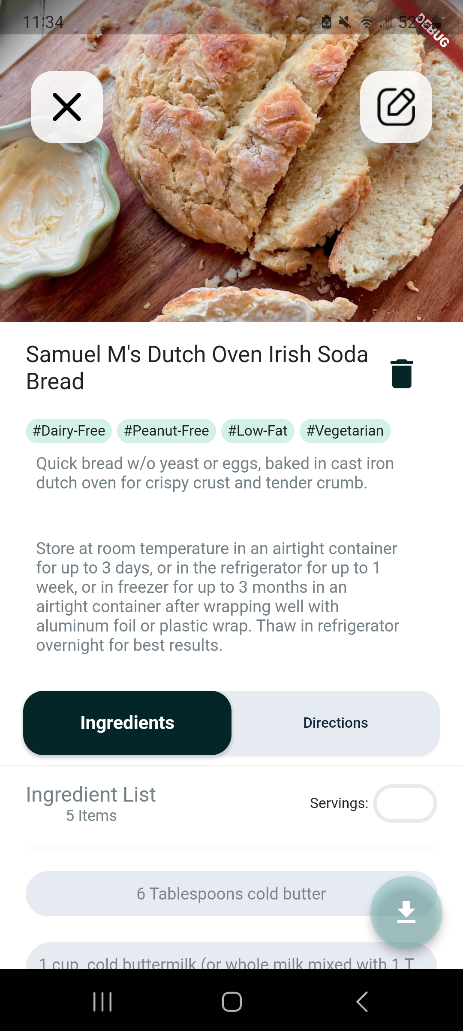
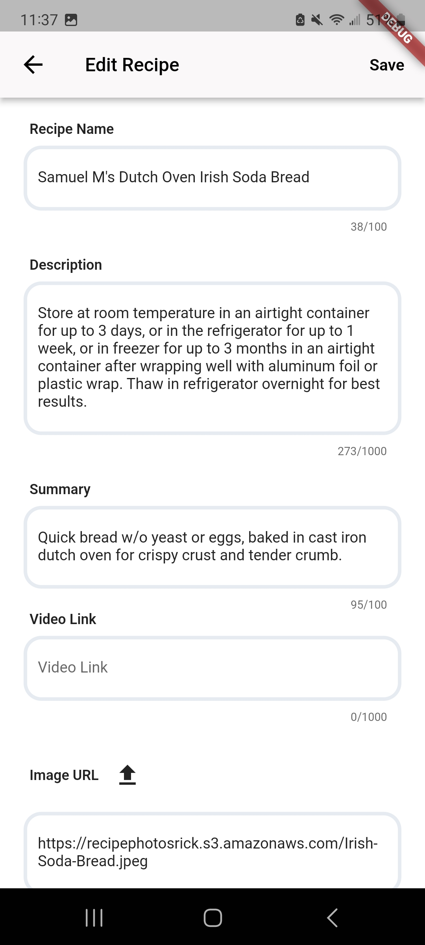
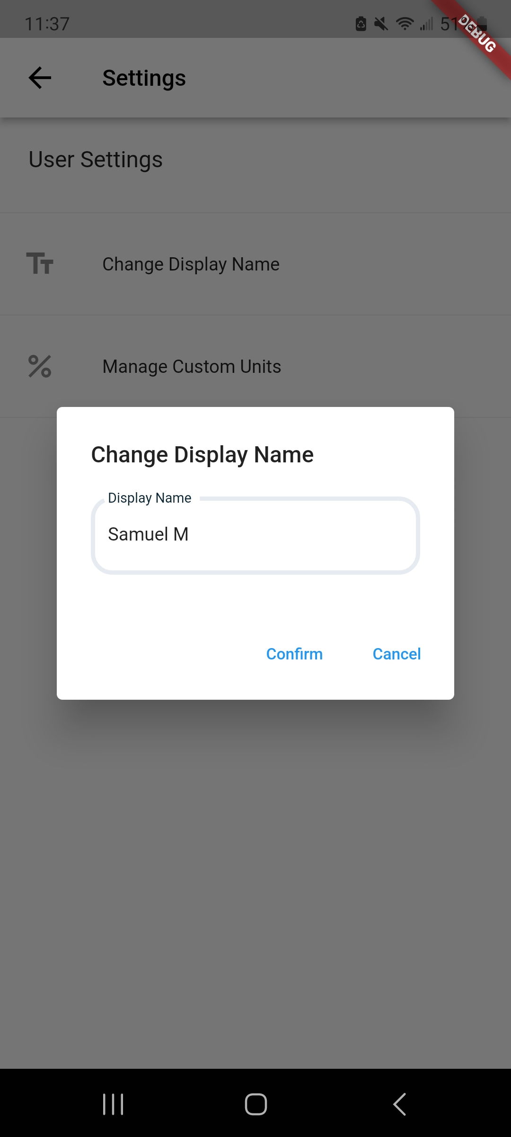

AllAboutFood – An Interactive Voice for Cooking Recipes
Samuel Munro, Andrew Sullivan, Zhen Yang, and Brock Buczkowski
Amazon Alexa
Firebase Hosting
AWS S3 and API Gateway
The Alexa Skill allows user to easily navigate their recipes with their voice while cooking.
Main Features
Ability to go back and forth through the ingredients/directions of a recipe.
Amazon template-based display, screens automatically scale and adjust for all available devices.
Ability search for a recipe from either public recipes or personal collection.
Recipe comparison view while searching for a recipe.
User Account Support, account-based access to personal recipes.
Support for opening linked web page from a recipe.
Support for displaying video from recipe.
Ability to check the amount of a specific ingredient while viewing the recipe's directions.
Hosts both the web build of the frontend and the linking site
Provides user authentication
Self-hosted images are necessary for a consistent look and feel
Allows the web build to get around CORS policies
AWS S3 provides convenient and cheap data storage
Frontend access provided through an AWS API Gateway
Flutter Client Application
Flutter enables multi-platform compatibility under one codebase
iOS, Android, and Web are all supported
Notable Features
Full CRUD access to the recipe database
User Account Management, including login-based access
Recipe Downloads and Forking
Communicates with a variety of internet services
AWS Lambda – secure database access
AWS S3 – uploading user images
Firebase Hosting and Authentication – account management
Reactive User Interface
Device-specific data storage
AWS Lambda
Provides layered access to the recipe database
Creating, editing, reading, and deleting recipes
Security protocol
Frontend sends user token
Function interprets user token, and checks the data against the data in Firebase
If authorized, the function executes its action on the database

